Slide 1
Smart Irrigation system for Marigold
CS21B1078 E SAILESWARA REDDY
CS21B1023 SK ARIAN ISLAM
CS21B1068 BASAB GHOSH
ME21B1068 DEVANJAAN SARKAR

Slide 2
CONTENTS
INTRODUCTION
LITERATURE REVIEW
GAPS IN EXISTING SOLUTIONS
METHODOLOGY & SOLUTION OVERVIEW
BILL OF MATERIALS
ROLES & RESPONSIBILITIES
DELIVERABLES
FUTURE WORK & CONCLUSION
SOURCES AND REFERENCES

Slide 3
INTRODUCTION
- Flourishing Market: In 2022-23, India exported 21024.41 MT of floriculture products worth Rs. 707.81 Crores/88.38 USD Million, with major destinations including the U.S.A, Netherlands, UAE, U.K, Germany, and Malaysia.
- Rising Potential: With increasing disposable income, changing lifestyles, and government initiatives, India's flower market is on the upswing, yet it holds untapped potential.
- Targeting Marigold: Our focus is on the lucrative Marigold market in India, aiming to enhance its productivity through innovative technology solutions.
- Smart Solutions: Leveraging IoT and Artificial Intelligence, our Smart Irrigation System for Marigold optimizes growth conditions by monitoring key metrics like pH and moisture levels.
- Optimal Conditions: Maintaining pH levels between 6.5 to 7, our system ensures the ideal environment for Marigold cultivation, boosting yield and quality.
- Combatting Challenges: Addressing productivity-reducing factors, our system includes an app capable of detecting and diagnosing 9 common diseases affecting Marigold plants, enabling timely intervention.

Slide 4
LITERATURE REVIEW
- Water Scarcity Driving Innovation: Dr. S. Velmurugan et al.'s work highlights the demand for IoT-based solutions amid water scarcity concerns, stimulating the development of open-source alternatives.
- Indonesia's Innovative Approach: Kaburan et al. propose an IoT-based micro-climate monitoring system tailored for Indonesia's horticulture sector, integrating automated intelligence to optimize productivity and quality while managing climate variability.
- Challenges in Indian Agriculture: Despite increased output, India's agricultural sector faces challenges such as limited arable land and declining farmer numbers. Wireless sensor networks offer a technology-driven solution, enabling precise monitoring and management of crops.
- Insights into Water Use Efficiency: Goldstein et al.'s meta-analysis sheds light on crop water use efficiency (WUE) in various environments, aiding in tailored crop selection strategies for effective agricultural management amidst changing climatic conditions.
- Empowering Agriculture with ML: Machine Learning (ML) integration with IoT systems revolutionizes agriculture, enhancing decision-making processes and enabling precision practices like targeted irrigation and fertilization. Algorithms like Random Forest and K-Means clustering analyze vast data for improved productivity and sustainability.

Slide 5
GAPS IN EXISTING SOLUTIONS
- Missing Linkages in IoT Research: Despite the extensive research in IoT for smart agriculture, a critical gap persists in modeling the intricate relationship between soil pH, moisture levels, and water requirements, especially for specific crops like marigold flowers.
- Lack of Standardized Solutions: The absence of standardized datasets and tailored algorithms for disease detection in crops remains conspicuous in existing literature, hindering comprehensive agricultural IoT frameworks.
- Piecemeal Solutions: Previous studies often offer fragmented solutions, neglecting to address systemic vulnerabilities within agricultural IoT systems, leaving them susceptible to potential disruptions.
- Holistic Approach: Our proposed product aims to bridge these gaps by offering a holistic approach, integrating advanced modeling techniques to understand the pH-moisture-water nexus, introducing novel datasets and algorithms for disease detection in marigold flowers, and emphasizing the importance of addressing systemic vulnerabilities.

Slide 6
GAPS IN EXISTING SOLUTIONS
- Nuanced Implementation: Our research emphasizes the need for a nuanced and comprehensive approach to IoT implementation in smart agriculture, moving beyond simplistic solutions to embrace the complexities of agricultural ecosystems.
- Precision Agriculture Enhancement: By explicitly addressing the interplay between soil parameters and water requirements, particularly for crops like marigold flowers, our framework seeks to enhance precision agriculture practices and optimize resource utilization.
- Resilience Building: Introducing novel methodologies for disease detection and emphasizing the identification and mitigation of system vulnerabilities, our research aims to bolster the resilience of agricultural IoT systems against potential disruptions.
- Advancing IoT Research: Through this multifaceted approach, we aim to contribute to the advancement of agricultural IoT research, fostering more robust and sustainable farming practices amidst evolving environmental and technological challenges.

Slide 7
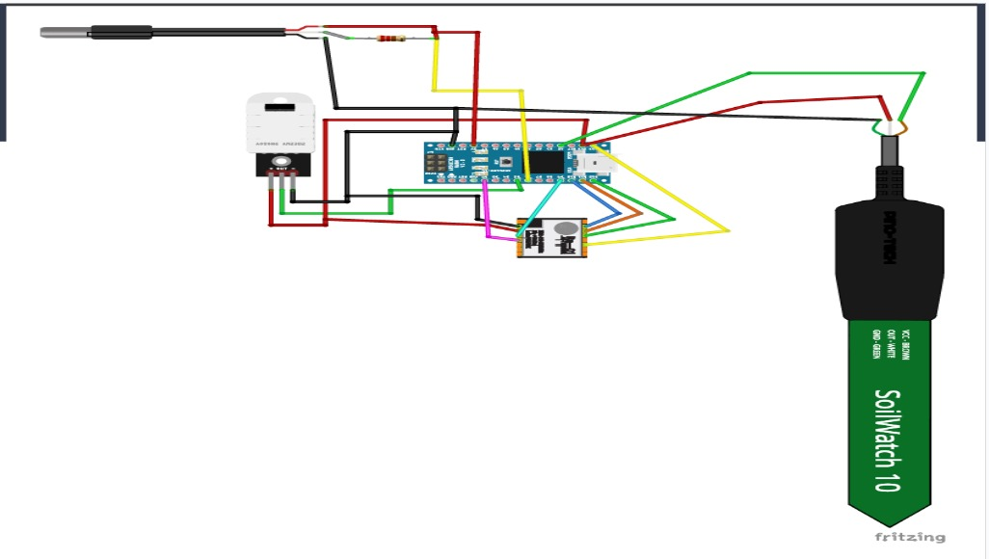
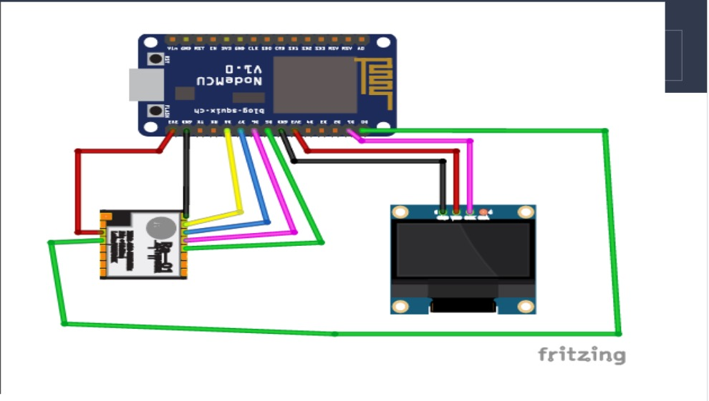
METHODOLOGY & SOLUTION OVERVIEW
Part 1: IoT Setup Overview :-
Hardware:
- Transmitter: Arduino Nano, LoRa Transceiver, Soil Moisture Sensor, Temperature & Humidity Sensors, Relay Module, Water Pump.
- Receiver: NodeMCU ESP8266, LoRa Module, OLED Display, Relay Module, Environmental Sensors.
Functionality:
- Transmitter collects and transmits sensor data, controls irrigation.
- Receiver displays data, uploads to Blynk IoT, enables remote monitoring.
LoRa Technology:
- Long-range communication (up to 5km).
- High sensitivity and power output, frequency hopping for signal quality.

Slide 8
METHODOLOGY & SOLUTION OVERVIEW
Blynk IoT Platform:
- User-friendly interface, remote monitoring and control via web/mobile apps, customizable data streams.
Project Setup:
- Hardware assembly, software configuration for data acquisition/transmission.
Data Monitoring:
- Real-time monitoring through LoRa and OLED display, comprehensive visualization via Blynk IoT.
Conclusion:
- Integrates hardware, LoRa, and Blynk for efficient monitoring and irrigation.
- Offers scalability and remote accessibility for global agricultural management.

Slide 9
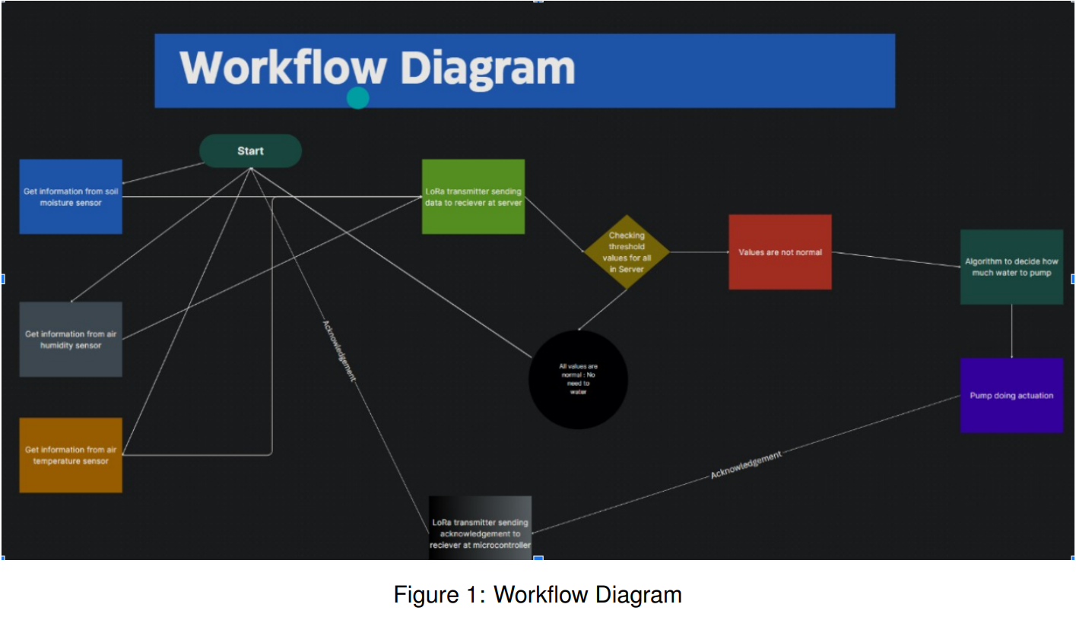
METHODOLOGY & SOLUTION OVERVIEW

Slide 10
METHODOLOGY & SOLUTION OVERVIEW
Part 2: Leveraging TinyVGG for Marigold Disease Detection :-
Introduction:
- Marigold faces significant disease threats impacting growth and yield, necessitating automated detection systems.
Dataset Creation:
- Compiled comprehensive dataset of marigold images with labeled diseases.
Model Selection:
- Utilized TinyVGG, optimized for resource-constrained environments, balancing complexity and efficiency.
Training Process:
- Employed transfer learning to fine-tune TinyVGG, adapting it for marigold disease detection.

Slide 11
METHODOLOGY & SOLUTION OVERVIEW
Evaluation and Performance:
- Achieved consistent accuracy of approximately 75% across various disease categories.
App Development:
- Developing user-friendly mobile app for instant disease detection using smartphone cameras.
Conclusion:
- Represents significant advancement in agricultural technology.
- Offers reliable and efficient disease detection for improved productivity.
- Envisions further enhancements and broader applications in agriculture.

Slide 12
METHODOLOGY & SOLUTION OVERVIEW
IMAGE

Slide 13
METHODOLOGY & SOLUTION OVERVIEW
IMAGE
CONVOLUTION
MAXPOOL

Slide 14
METHODOLOGY & SOLUTION OVERVIEW
IMAGE
CONVOLUTION
MAXPOOL
CONVOLUTION
MAXPOOL
FLATTEN
DENSE

Slide 15
METHODOLOGY & SOLUTION OVERVIEW
IMAGE
CONVOLUTION
MAXPOOL
CONVOLUTION
MAXPOOL
FLATTEN
DENSE
PROB. OF CLASSES (SOFTMAX)

Slide 16
BILL OF MATERIALS
S. No. | Component Name | Quantity (pc) | Rate (Rs.) | Cost (Rs.)
1 | SSX1278 LoRa Module Ra- 02 433MHZ Wireless Spread Spectrum Transmission | 2 | 501 | 1002
2 | Songle Single-channel 5V 30A Relay Module Power Failure Relay | 1 | 162 | 162
3 | Horizontal Mute Sounds Mini Submersible Pump DC 3V-5V | 1 | 99 | 99
4 | NodeMcu ESP8266 V3 Lua CH340 Wifi Dev. Board | 1 | 175 | 175
5 | Robotbanao DS18B20 Waterproof Digital Temperature Sensor Probe | 1 | 202 | 202
6 | Xcluma DTH22 AM2302 Digital Temperature and Humidity Sensor Module | 1 | 337 | 337
7 | Scriptronics Capacititive Soil Moisture Sensor Module | 1 | 199 | 199
8 | Maison Up Nano board CH340/ATmega328P | 1 | 499 | 499
9 | ApTechDealsBreadboard 840 points with jumper wires set(10+10+10) | 2 | 268 | 536
10 | Maison Up 0.96” I2C/IIC 4-Pin OLED Display Module | 1 | 448 | 448
11 | Soldering Equipment | 1 | 459 | 459
 | Grand Total | 13 |  | 4118

Slide 17
ROLES & RESPONSIBILITIES
Basab Ghosh (CS21B1068)
- Leads machine learning model development for disease classification in marigolds.
- Implements CNN model and statistical ML models for optimal marigold requirements.
- Achieved 75% accuracy in disease classification and developing accompanying app.
E. Saileswara Reddy (CS21B1078)
- Coordinates sub-problems: ML, Assembly, and IoT integration.
- Researches marigold diseases, gathers dataset, and selects materials.
- Assists in ML model preparation and IoT system implementation.
- Documents team progress for review meetings.

Slide 18
ROLES & RESPONSIBILITIES
SK Arian Islam (CS21B1023)
- Leads IoT system implementation for monitoring soil parameters.
- Utilizes LoRa Module for data transmission to mobile devices and internet servers.
- Develops user interface website for customer interaction.
- Integrates sensor data manipulation for efficient product performance.
Devanjaan Sarkar (ME21B1068)
- Designs circuits, especially for the LoRa module, integrating soil sensors and irrigation control.
- Collaborates with Sailesh on irrigation system implementation.
- Assists in dataset collection, IoT system documentation, and IoT module optimization.
- Contributes to compact circuit design for rugged marigold fields.
- Assembles prototype components with the team upon acquisition.

Slide 19
DELIVERABLES
Smart MariGold Agriculture Monitoring System:
Project Plan Document:
- Outlines objectives, scope, stakeholders, and team roles.
- Establishes timeline with milestones for IoT system development.
Hardware Setup and Configuration:
- Documents required hardware components and provides assembly instructions.
- Ensures compatibility and connectivity of sensors and LoRa modules.
Software Development:
- Develops firmware for data collection and transmission via LoRa.
- Implements communication protocols and backend server application.

Slide 20
DELIVERABLES
Data Visualization Dashboard:
- Develops web/mobile dashboard for real-time sensor data visualization.
- Includes key metrics and features for historical data analysis.
Integration and Testing:
- Integrates hardware and software components, conducts rigorous testing.
- Performs field testing to validate system performance in agricultural environments.
Deployment and Maintenance:
- Deploys IoT system, provides maintenance guidelines and security protocols.

Slide 21
DELIVERABLES
Machine Learning Model for Analyzing Anomalies in Marigold Plants:
Project Plan Document:
- Defines objectives, scope, stakeholders, and timeline for model development.
Data Collection and Preprocessing:
- Gathers and preprocesses dataset for model training and validation.
Model Development:
- Designs CNN architecture for image classification, implements model using deep learning framework.
Model Training and Evaluation:
- Trains model on preprocessed dataset, evaluates performance using various metrics.
Deployment and Integration:
- Deploys trained model for inference, integrates with IoT system for real-time anomaly detection.

Slide 22
FUTURE INNOVATIONS
Enhancing Automated Irrigation System:
- Continuously refine and enhance the automated irrigation system to ensure optimal water and resource management. This could involve further research into advanced sensor technologies, improved data analytics algorithms, and enhanced control mechanisms. By making the system more responsive and adaptable, we can maximize its effectiveness across a wider range of crops and environmental conditions.
Expanding AI Applications:
- Expand the scope of AI applications beyond disease detection to tackle other critical agricultural challenges. This could include developing AI-driven solutions for predicting crop yields, optimizing pest management strategies, and monitoring soil health. By leveraging AI technologies across various aspects of farming, we can unlock new opportunities for improving productivity and sustainability in agriculture.
Fostering Collaborative Partnerships:
- Foster collaborative partnerships with key stakeholders in the agricultural ecosystem, including farmers, agronomists, research institutions, and technology companies. By working closely with these partners, we can leverage their expertise and insights to co-create innovative solutions that address real-world agricultural needs. Collaborative efforts can also facilitate knowledge sharing, accelerate technology adoption, and drive positive impact at scale.

Slide 23
CONCLUDING REMARKS
Transformation in Farming Practices:
- Our project represents a transformative shift in farming practices by harnessing the power of AI and IoT technologies. By integrating these advanced solutions, we empower farmers with actionable insights and automated tools for better decision-making and resource management. This not only enhances productivity but also promotes sustainability in agriculture.
Commitment to Sustainability:
- We are deeply committed to sustainability and environmental stewardship in agriculture. Our ongoing efforts aim to minimize environmental impact, conserve natural resources, and promote regenerative farming practices. By prioritizing sustainability, we strive to create a more resilient and equitable food system that benefits both present and future generations. Through continuous innovation and collaboration, we will continue to drive positive change and contribute to a more sustainable future for agriculture.

Slide 24
SOURCES AND REFERENCES
1. An IOT-based Smart Irrigation System using Soil Moisture and Weather Prediction[Dr. S. Velmurugan, V.
Balaji, T. Manoj Bharathi, K. Saravanan]
2. A Design of IoT-based Monitoring System for Intelligence Indoor Micro-Climate Horticulture Farming in
Indonesia[Emil Robert Kaburuan , Riyanto Jayadi , Harisno ]
3. Smart Farming: Internet of Things (IoT)-Based Sustainable Agriculture [Muthumanickam Dhanaraju ,Poongodi Chenniappan ,Kumaraperumal Ramalingam ,Sellaperumal Pazhanivelan andRagunath Kaliaperuma]
4. IoT-based Smart Gardening System[Gauri R Choudhari, Pratik A Dagale, Isha S Dashetwar, Rutuja R Desai
and Abha A Marathe]
5. IoT-Based Systems for Soil Nutrients Assessment in Horticulture[Stefan Postolache ,Pedro Sebastião ,Vitor
Viega,Octavian Postolache, Francisco Cercas]
6.Applying machine learning on sensor data for irrigation recommendations: revealing the agronomist’s tacit
knowledge[Anat Goldstein, Lior Fink, Amit Meitin, Shiran Bohadana, Oscar Lutenberg & Gilad Ravid ]
7.IoT, Environmental Sustainability, Agricultural Supply Chains[Selwyn Piramuthu]
8. Smart Agriculture System Using IoT and ML[R Arthi.; S Nishuthan; L Deepak Vignesh]

